Slide 1

Nested Dictionary

Slide 2
Data Types
Data Type | Examples
integer | 22, 5, 94, -30, -24
float | 0.5, 1.25, 3.14, -4.5, -2.7
string | “hello”, “4 cats”, “a”, “aa”, “7”
boolean | True, False
list | [“Rejep”, “Meret”, “Oraz”, “Gurban”]
dictionary | {“book” : “kitap”, “read” : “okamak”}

Slide 3
What is the Nested Dictionary?
A nested dictionary is a dictionary within another dictionary. It's a powerful data structure for organizing complex, hierarchical data.

Slide 4
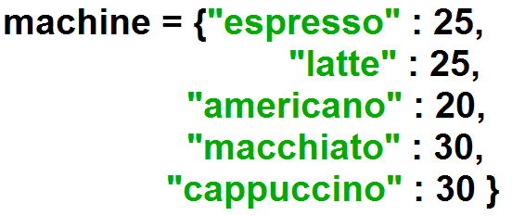
Dictionary

Slide 5
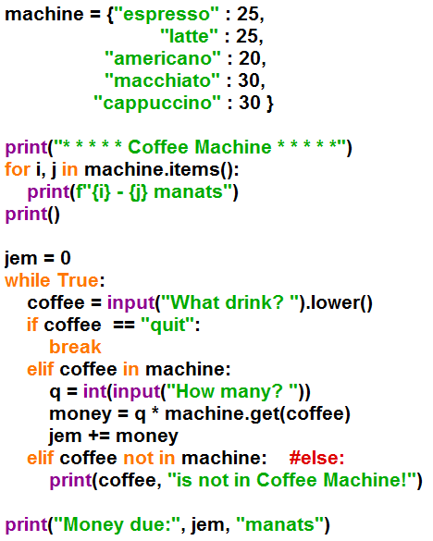
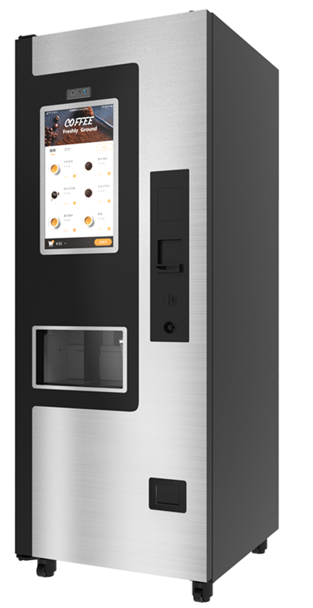
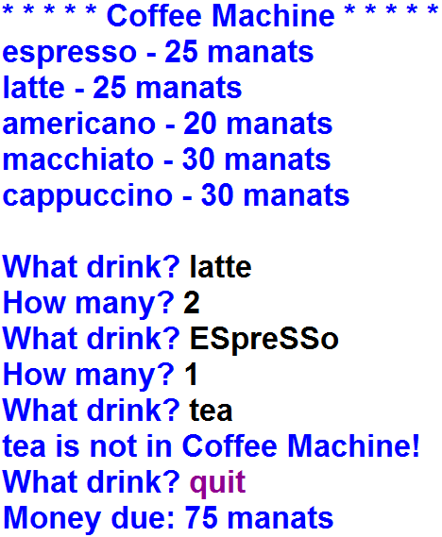
Example:

Slide 6
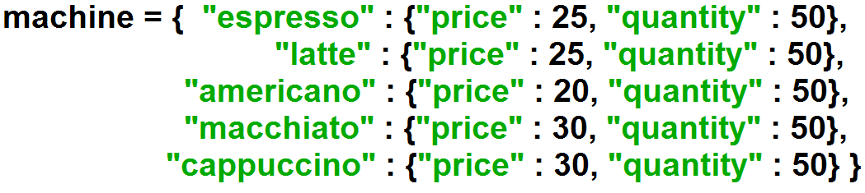
Nested Dictionary

Slide 7
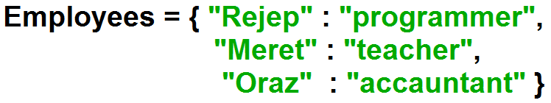
Create Dictionary

Slide 8
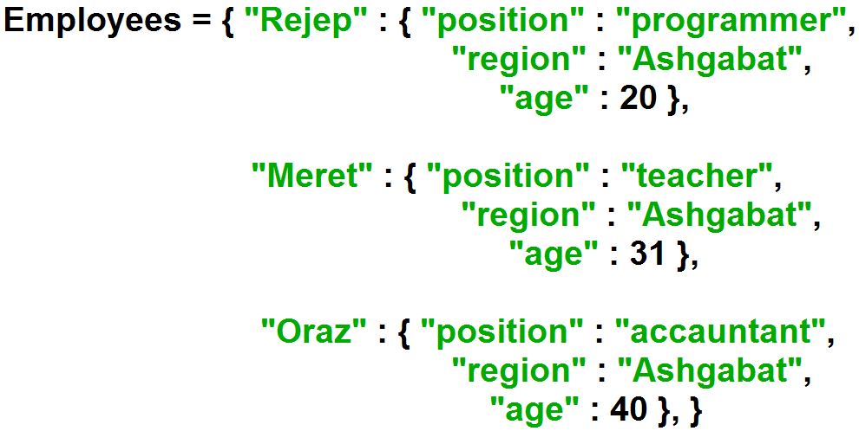
Create Nested Dictionary

Slide 9
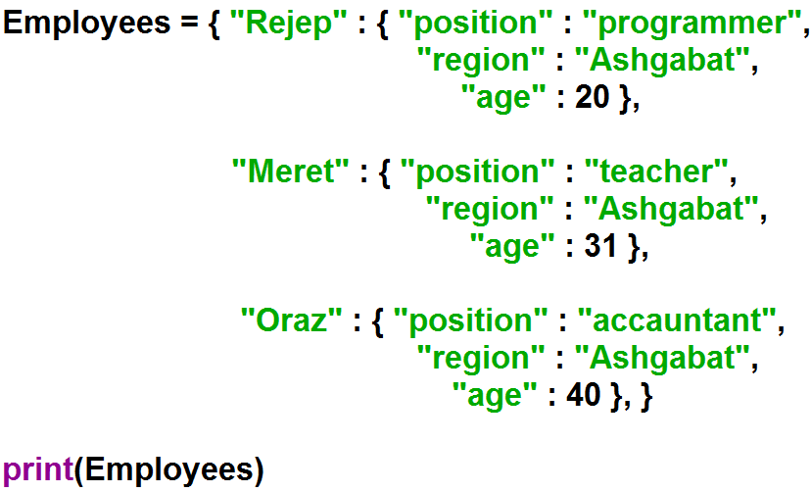
Print Nested Dictionary

Slide 10
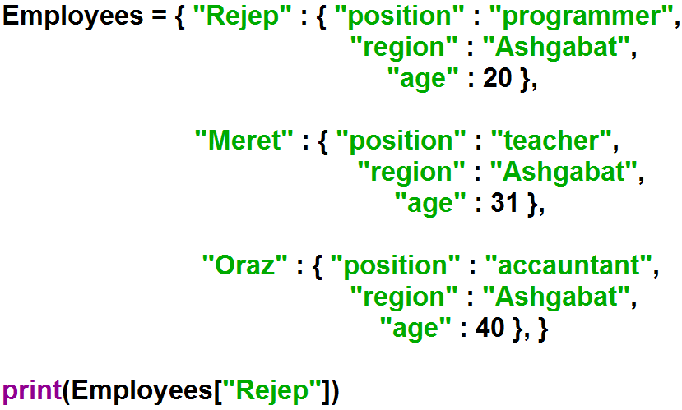
Accessing Items

Slide 11
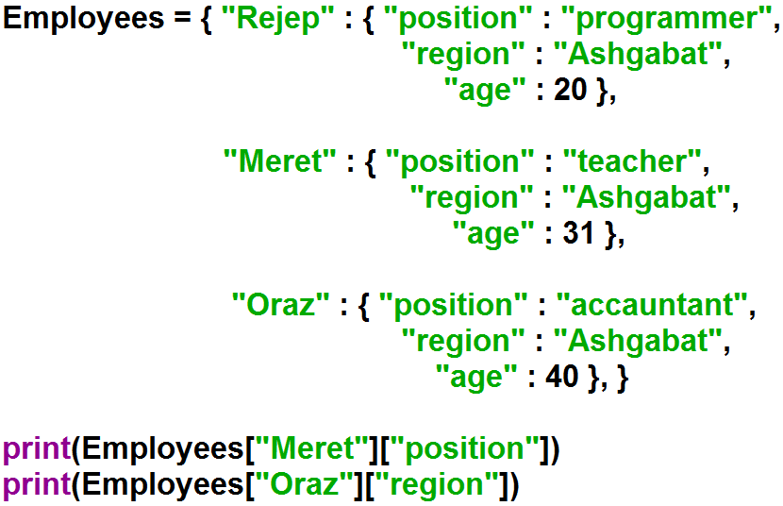

Accessing Items

Slide 12
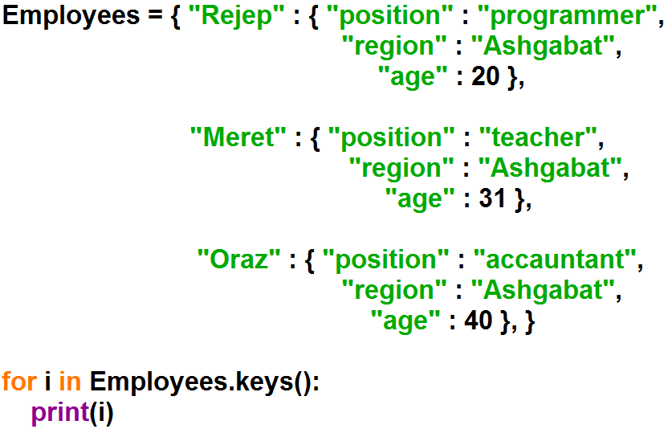

Loop Through Nested Dictionaries

Slide 13
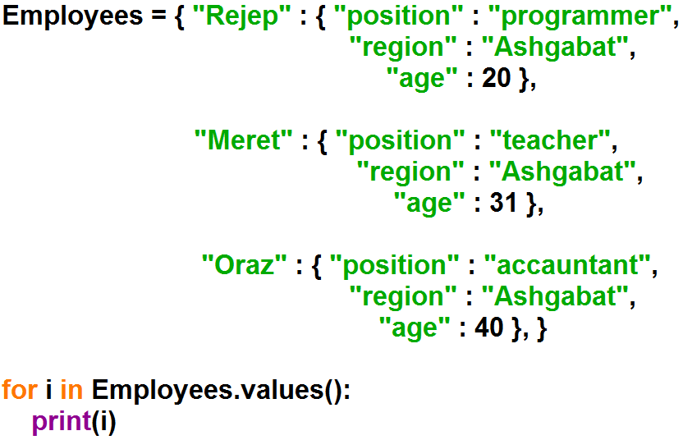
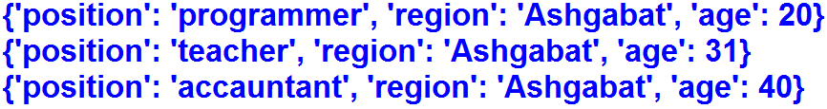
Loop Through Nested Dictionaries

Slide 14
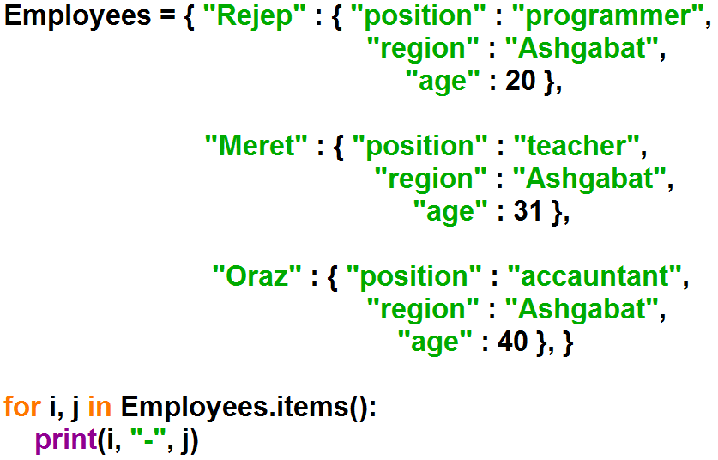
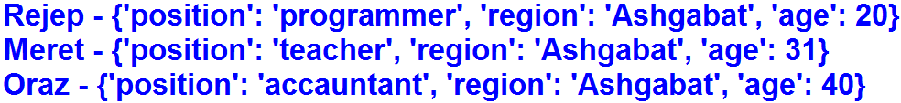
Loop Through Nested Dictionaries

Slide 15
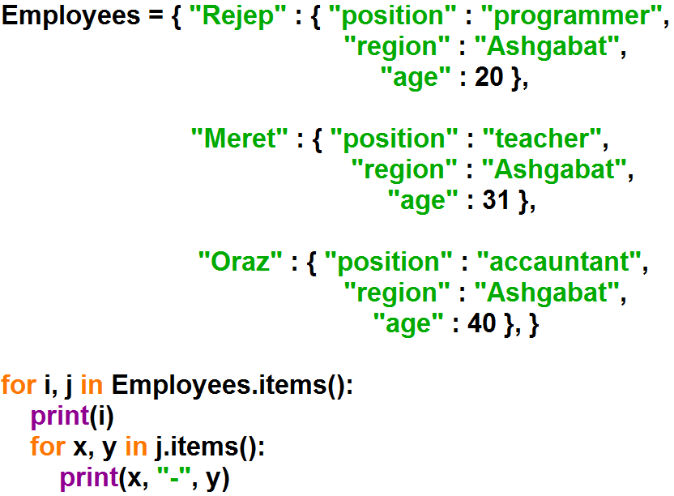
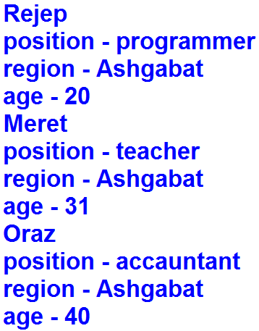
Loop Through Nested Dictionaries

Slide 16
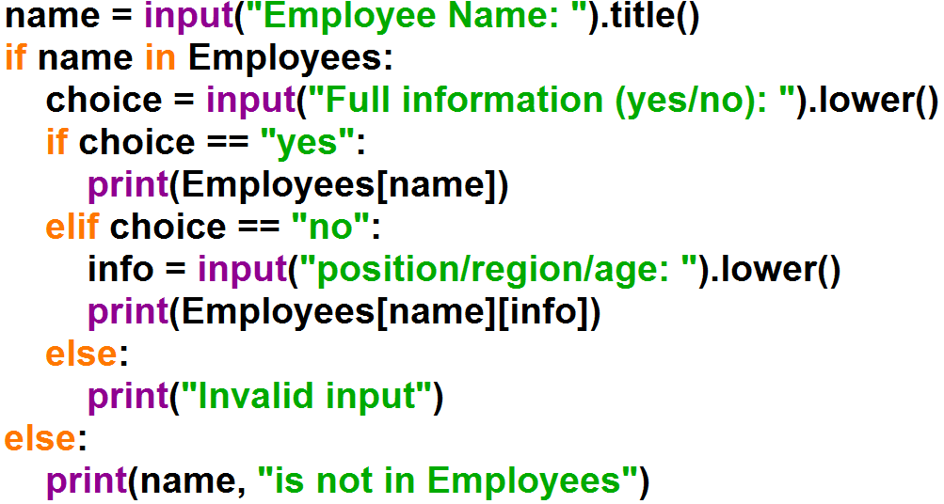
Example:

